Slide 1
AI Resume & Portfolio Builder
CAPSTONE PROJECT
Presented By:
Student Name - Mohammed Abdul Rahman
College Name – JNTUH University College of Engineering Palair
Department – Computer Science Engineering

Slide 2
OUTLINE
Problem Statement (Should not include solution)
Proposed System/Solution
System Development Approach (Technology Used)
Algorithm & Deployment
Result
Conclusion
Future Scope
References

Slide 3
Problem Statement
.
Many students struggle to present their skills and projects in an attractive, professional format. Generic resume templates don’t highlight individual strengths. A generative AI solution is needed that can automatically generate tailored resumes, cover letters, and portfolios based on student data, improving job and internship opportunities.
Common issues include:
- Lack of resume-building knowledge
- Poor formatting and structure
- Difficulty showcasing skills and projects
- Low ATS compatibility
These challenges reduce opportunities for internships and placements.

Slide 4
Proposed Solution
Develop an AI Resume & Portfolio Builder web application using Streamlit and Python that helps users:
- Create professional resumes instantly
- Organize educational and project details
- Analyze skills and suggest suitable career roles
- Estimate ATS scores
- Download generated resumes

Slide 5
System Approach
Frontend
Streamlit Interface
User Input Forms
Backend
Python Logic
Resume Generation Engine
ATS Evaluation Module
Development Tools
VS Code
GitHub
Streamlit Cloud

Slide 6
Algorithm & Deployment
Algorithm
Accept user details
Process education, skills, projects, and certifications
Generate formatted resume
Analyze skills
Display ATS score
Recommend career roles
Enable download option
Deployment
GitHub Repository - https://github.com/mohdrahman-ai/AI-Resume-and-Portfolio-Builder
Streamlit Cloud - https://ai-resume-and-portfolio-builder-09.streamlit.app/

Slide 7
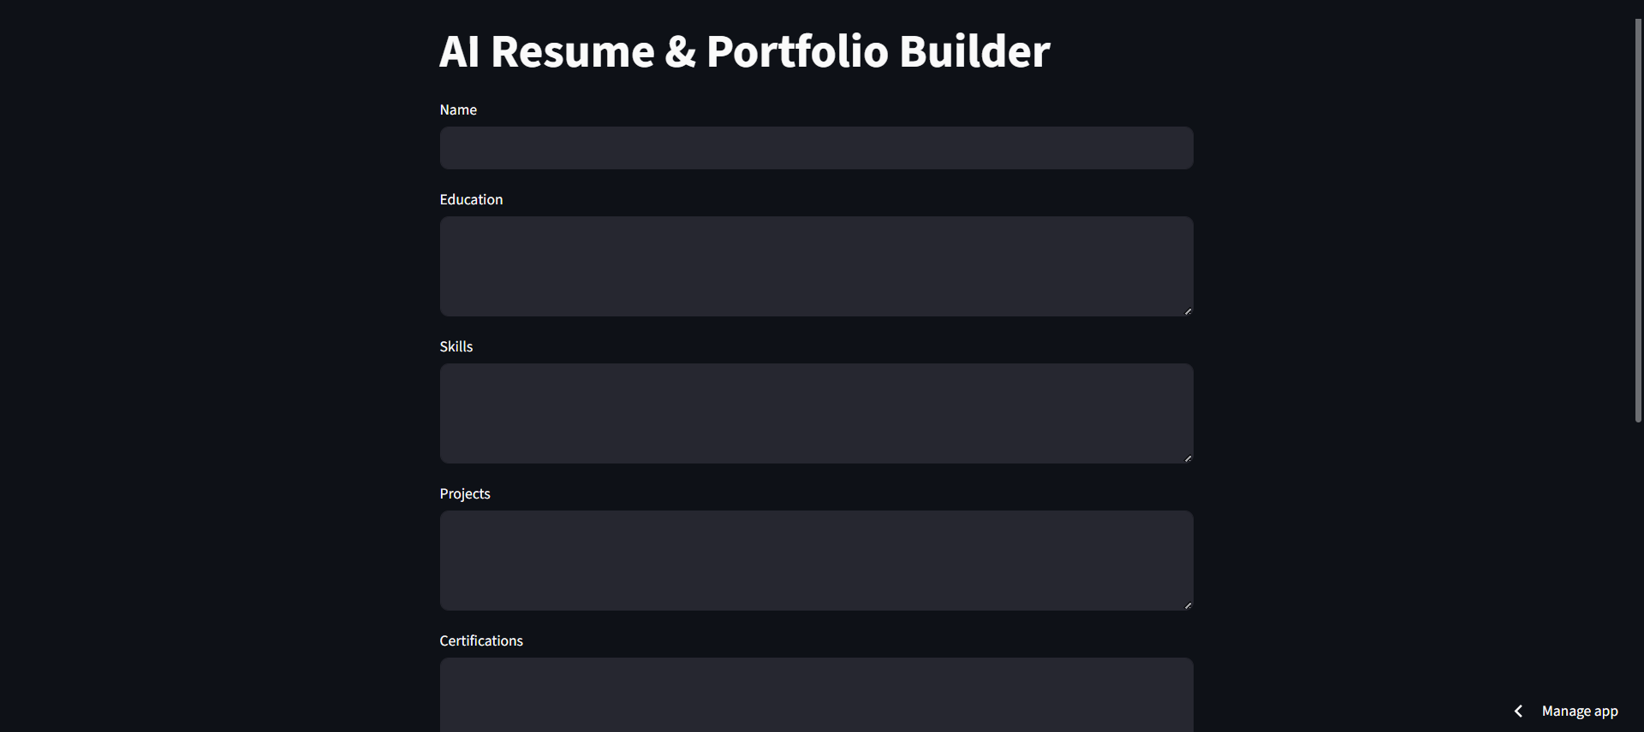
Result
Streamlit AI Resume and Portfolio Builder app user interface -

Slide 8
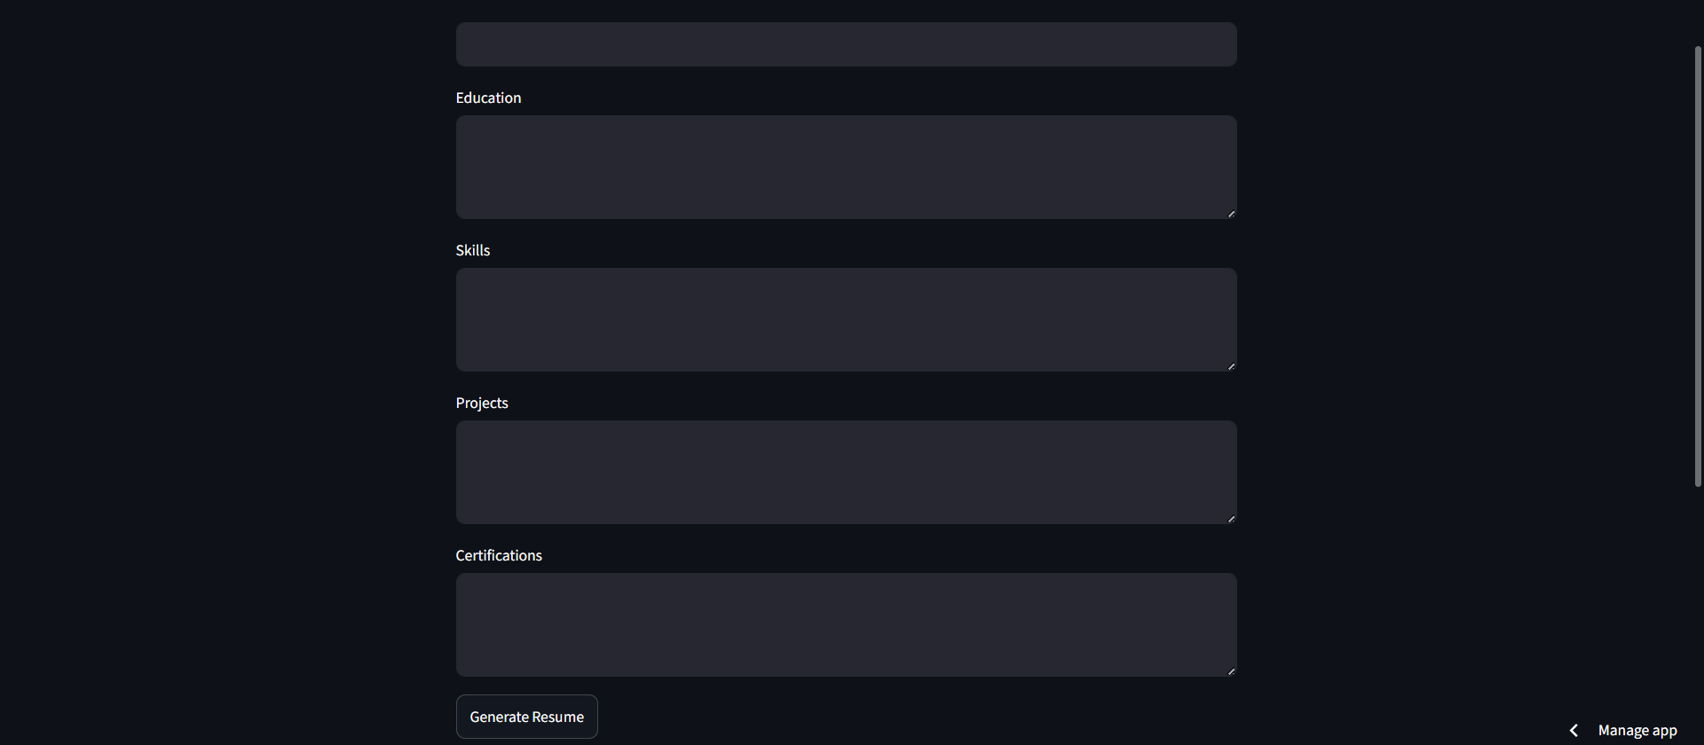
User Interface-

Slide 9
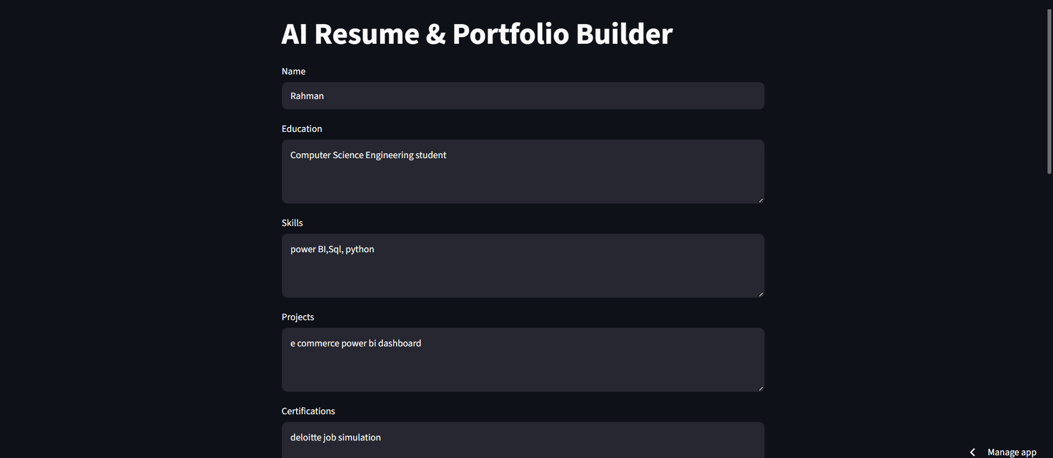
Input-

Slide 10
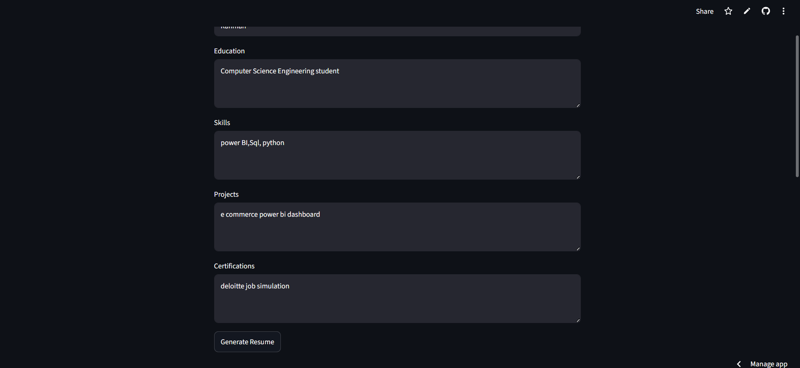
Input -

Slide 11
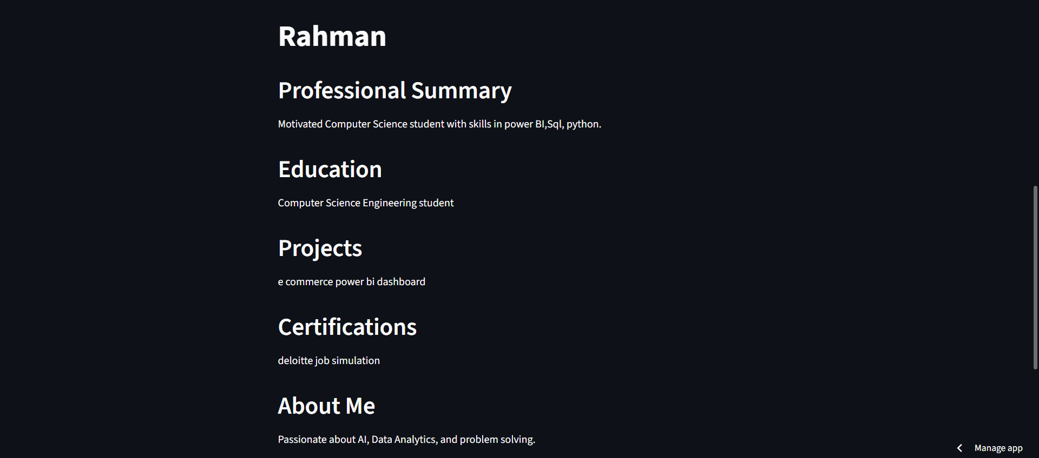
Result generated Successfully -

Slide 12
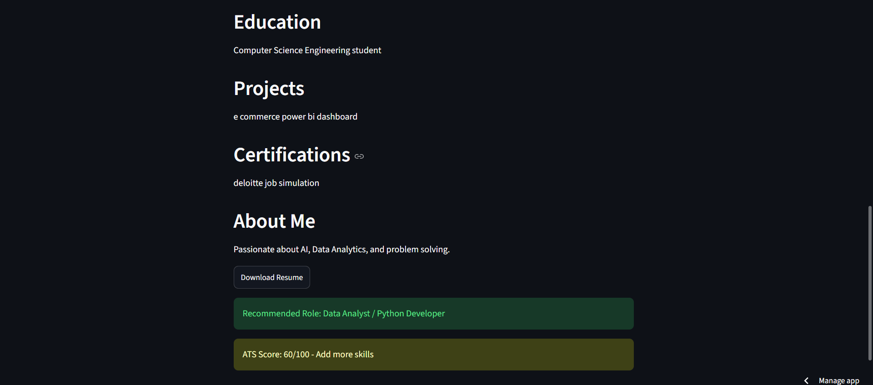
Resume created successfully with ATS score and Recommended role with Download Resume Option -

Slide 13
Conclusion
The AI Resume & Portfolio Builder simplifies resume creation for students and job seekers.
The project successfully:
Generates professional resumes
Estimates ATS scores
Recommends career paths
Improves resume-building efficiency
This project demonstrates the practical application of Python and Streamlit in solving real-world career development problems.

Slide 14
Future scope
Integration with AI models to generate more professional and personalized resumes.
Support for exporting resumes in multiple formats such as PDF, DOCX, and HTML.
Advanced ATS (Applicant Tracking System) score analysis with detailed suggestions.
Automatic skill recommendations based on job descriptions.
Portfolio website generation alongside resume creation.
Integration with LinkedIn and GitHub for automatic profile data import.
Resume templates for different industries and career levels.
Multilingual resume generation to support global job applications.
Real-time job role recommendations based on user skills and qualifications.
Cloud database integration to save and manage multiple resumes securely.

Slide 15
References
- Streamlit Documentation – https://docs.streamlit.io
Python Official Documentation – https://docs.python.org
- GitHub – https://github.com
- Streamlit Community Cloud – https://streamlit.io/cloud
- Visual Studio Code (VS Code) Online Python - https://code.visualstudio.com/
Python version - https://www.python.org/downloads/release/python-3119/-
Streamlit • A faster way to build and share data apps

Slide 16
Github link
Github Link : https://github.com/mohdrahman-ai/AI-Resume-and-Portfolio-Builder
Streamlit Deployment Link: https://ai-resume-and-portfolio-builder-09.streamlit.app/

Slide 17
THANK YOU

